Slide 1
OVERLAY AVAILABILITY CANARY

Slide 2
INTRODUCTION
Welcome to my presentation on "Invoking Object Storage from an Overlay Instance using Instance Principal Authentication."
Today, we will discuss how I focused on leveraging Instance Principal Authentication in our project to interact with object storage.
With Instance Principal Authentication, we eliminate the need for custom authentication methods, providing a streamlined approach.
Additionally, we were able to perform CRUD operations by utilizing API's like the V2 Casper client API.
Let's delve into the details and discover the benefits and outcomes of our project.

Slide 3
MOTIVATION

Slide 4
User Principal Authentication
User Principal Authentication Overview:
User Principal Authentication allows users to authenticate and access OCI resources using their user credentials.
With User Principal Authentication, users can access OCI services and perform operations based on their assigned permissions and roles.
Steps for User principal Authentication:
Obtain an Authentication Token
Include Token in Requests
Validate the Token
Access Resources

Slide 5
Instance Principal Authentication
Instance Principal Authentication Overview:
Instance Principal Authentication allows compute instances within OCI to authenticate and access resources without using explicit credentials.
Instances have their own identity and can authenticate themselves using cryptographic keys and the OCI metadata service.
Authentication is based on retrieving an authentication token from the metadata service, which is specific to the instance.
Instances are assigned policies and permissions through dynamic groups, allowing them to access specific OCI resources based on their roles and policies.
Instance Principal Authentication is commonly used for programmatic access by applications, scripts, or services running on compute instances.

Slide 6
Instance Principal Authentication
2. Steps for Instance principal Authentication:
Create a dynamic group: A dynamic group is used to define a set of instances that will have the instance principal authentication.
Create a policy: Created a policy that allows the required permissions for my instance. For example, if my case, the instance needed access to Object Storage, so I created a policy that allows the dynamic group to manage objects in that Object Storage bucket.
Assign the dynamic group to the instance: Once the dynamic group and policy are created, I assigned the dynamic group to my instance.
Retrieve instance metadata: Instance principal authentication relies on retrieving metadata from the instance.
Use instance principal authentication: Now that the instance is configured with instance principal authentication, I used the retrieved metadata to authenticate my requests to OCI services. The metadata contains an authentication token that was used for API requests.

Slide 7
What I have done and learned
Navigating and Modifying the Existing Codebase:
Acquired a comprehensive understanding of the codebase structure and architecture.
Gained proficiency in navigating through the existing codebase and making necessary modifications.
Invoking Object Storage with Instance Principal Authentication:
Successfully learned and implemented the usage of Instance Principal Authentication to interact with object storage.
Utilized Instance Principal Authentication as a secure and efficient method for accessing object storage.
Validating CRUD Operations with V2 Casper Client API:
Verified the functionality of CRUD operations with the V2 Casper client API.
Confirmed that CRUD operations were successfully executed when utilizing Instance Principal Authentication.

Slide 8
What I have done and learned
Limitations of Instance Principal Authentication with Swift and AmazonS3 APIs:
Conducted thorough checks and observed that Instance Principal Authentication did not work with Swift and AmazonS3 APIs.
Identified a limitation where Instance Principal Authentication was incompatible with Swift and AmazonS3 APIs.
Further analysis is required to determine alternative authentication methods for these APIs.
Implementing Instance Principal Authentication for Specific APIs:
Developed a code separation approach by utilizing an environment variable to invoke Instance Principal Authentication selectively for the applicable APIs.
Understanding the Network Architecture of the Overlay Availability Canary:
Acquired knowledge about the underlying network architecture involved in the overlay availability canary.
Explored the components and connections within the network architecture to gain a comprehensive understanding of its functioning.

Slide 9
What I have done and learned
Basics of Telemetry and Monitoring Query Language (MQL):
Obtained a fundamental understanding of Telemetry and its significance in monitoring systems.
Explored the Monitoring Query Language (MQL) to analyze and extract valuable insights from telemetry data.

Slide 10
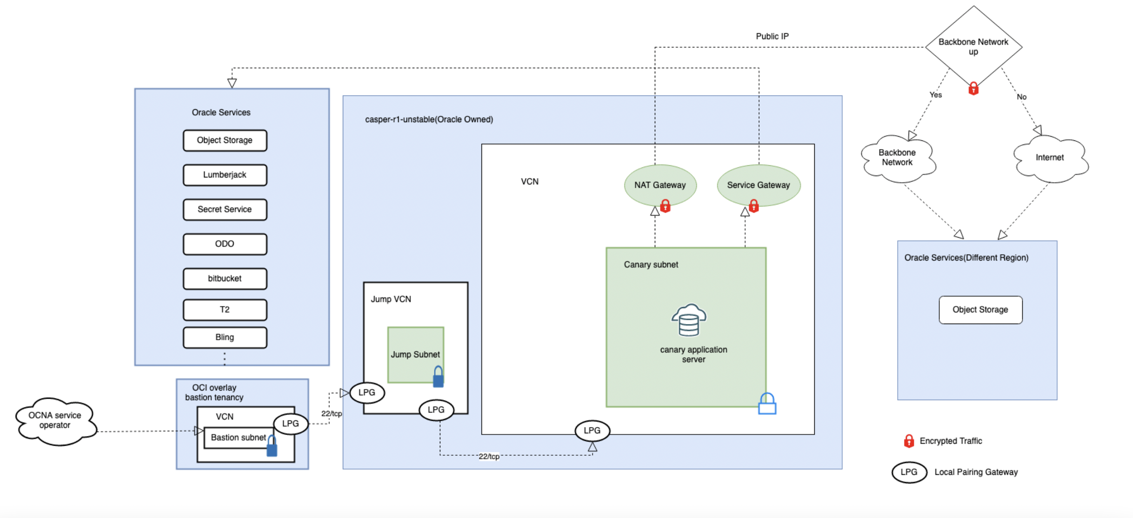
Network Architecture

Slide 11
Future Prospects
Integrating Telemetry for Metrics Monitoring:
By leveraging telemetry, we can gather valuable insights about the system's performance, usage patterns, and resource utilization.
This data can be utilized to create a comprehensive dashboard, providing real-time visibility into the canary's metrics.
Setting Up a Dashboard with MQL and Grafana:
By combining Monitoring Query Language (MQL) with Grafana, we can build an interactive and visually appealing dashboard.
The dashboard will display critical metrics obtained through telemetry, enabling stakeholders to monitor and analyze the canary's performance at a glance.
Implementing Timely Error Notifications:
To ensure prompt response to errors encountered within the canary, we can establish alarm mechanisms.
By setting up alarms based on specific metrics thresholds, we can receive real-time notifications when errors occur.

Slide 12
Thank You

